Slide 1
National summary Page Screenshots
The same presentation is found on the State and LGA tabs but for data specific for an individual unit at those levels.

Slide 2
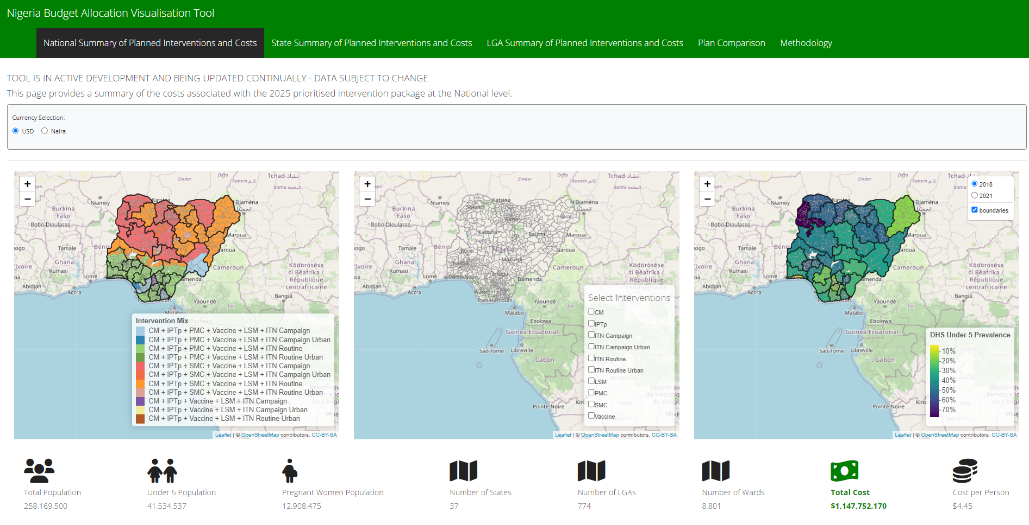
Notes:
The App opens onto this as the landing page – this page provides a National Level summary of the costs associated with the 2025 plan. ​
​
The first thing you can do is select the currency to display in the app ​
​
The three maps show: 1) the different intervention mix’s programmed at each LGA – you can zoom in on the maps and hover over the LGAs for more details 2) A summary of LGAs selected for each intervention shown by clicking the different interventions in the ‘Select Intervention’ box and 3) DHS estimates of the Under 5 PfPR – where the years can be toggeled in the top right. ​
​
Under the maps we see some key summary statistics on the demographics and admin levels and highlighted in green is the total cost associated with the intervention package. ​
​
<scroll to next page slide == scrolling down on the app> ​

Slide 3
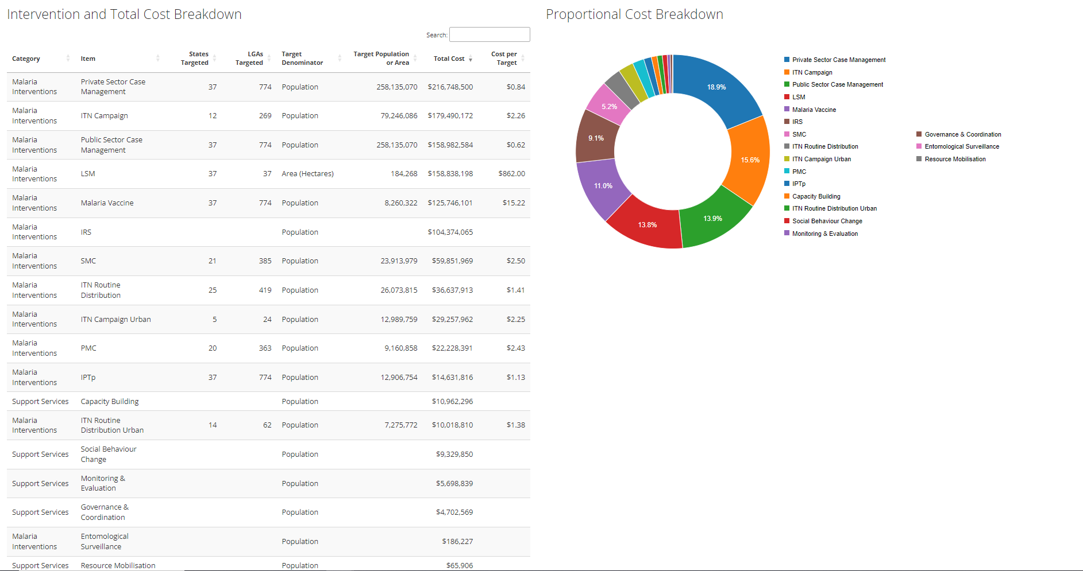
Notes:
Scrolling down brings us to a summary of the total costs for each of the malaria interventions and support services associated with the intervention package. ​
​
The table is interactive and can be ordered for each col by clicking on the title heading – it gives us the associated total cost (procurement + implementation etc) of each intervention and the total cost of the support services. ​
The proportional cost breakdown represents the proportion of the total cost associated with each intervention from largest to smallest. ​
​
<scroll down to next slide == scrolling down on the app>​ ​ !! Note that the private sector case management costs are currently the most $$ aspect of the current plan!! ​
​ ​

Slide 4
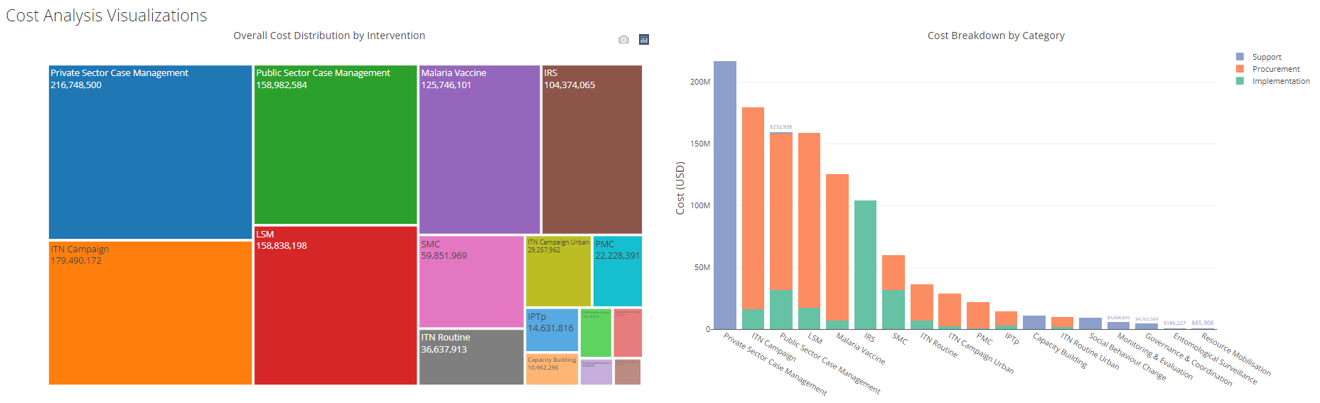
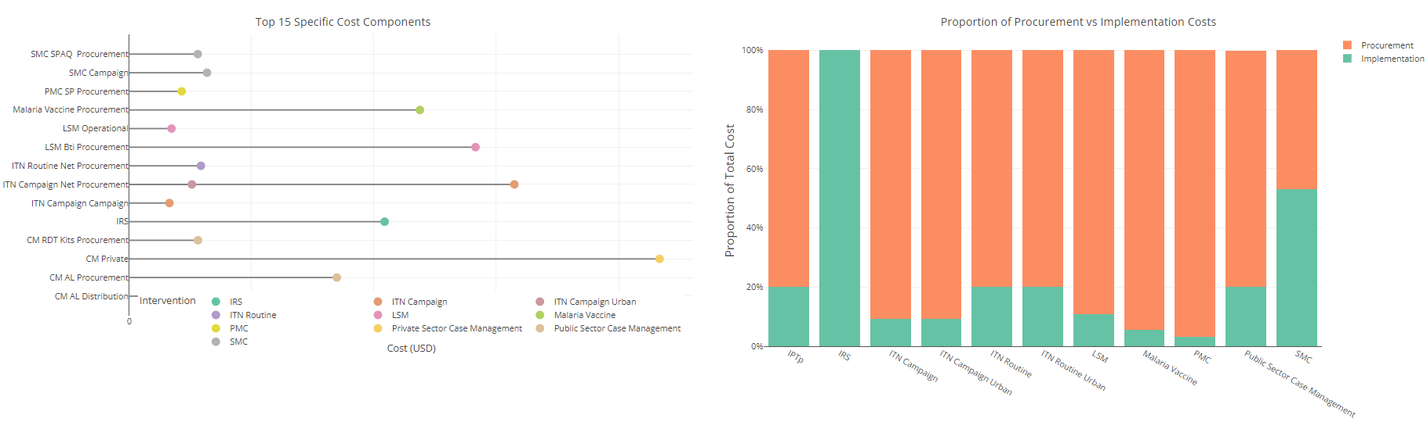
Notes:
The further you scroll down we provide some additional figures surrounding the cost breakdown of the different malaria interventions. Each plot is interactive and can be zoomed in to and each plot has hover tool tips that display the values for each of the bars or points shown. ​
​
The first is the cost distribution for each intervention – the larger the square the larger the cost associated with the intervention/ support service​
The second is a cost breakdown by intervention by category (procurement, implementation or support service) ​
The third highlights the top 15 most costly elements of the intervention package ​
And the fourth the proportion of the intervention total costs that is procurement vs implementation ​
​
!! Note that the private sector case management costs are currently the most $$ aspect of the current plan – these costs were recently added by the costing consultant into the spreadsheet but we think this needs a bit of refinement in terms of estimation so likely will change just wanted to flag that in case someone asks!!

Slide 5
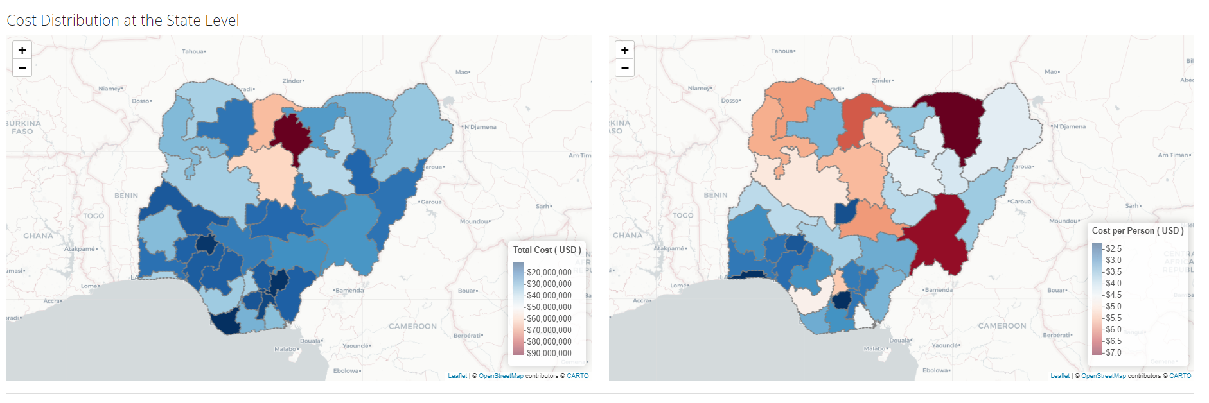
Notes:
Finally the total cost of intervention packets at the state level are shown geographically by total and by cost per person (state total pop)

Slide 6
Individual plots

Slide 7
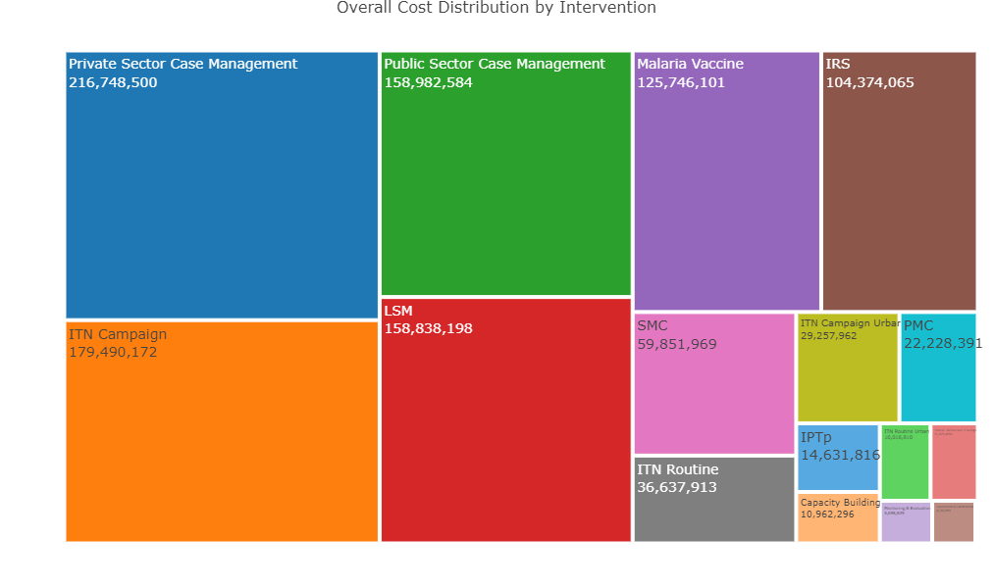

Slide 8
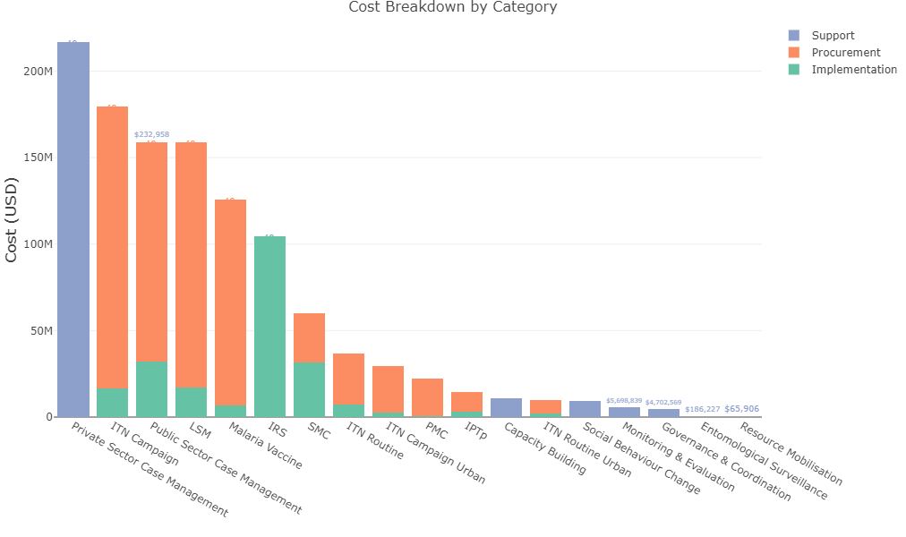

Slide 9
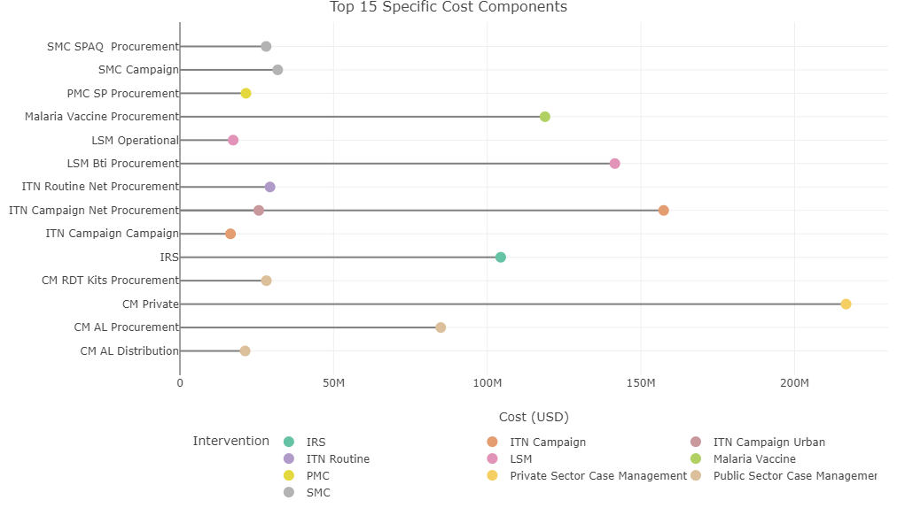

Slide 10
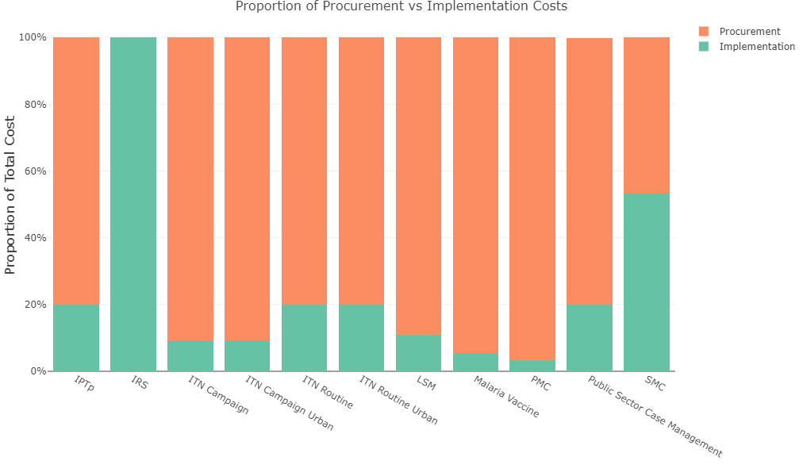

Slide 11
Plan Comparison Page Screenshots
An example of the type of comparisons that can be built into the tool to aid in the easy comparison of changes to the prioritized intervention plan

Slide 12
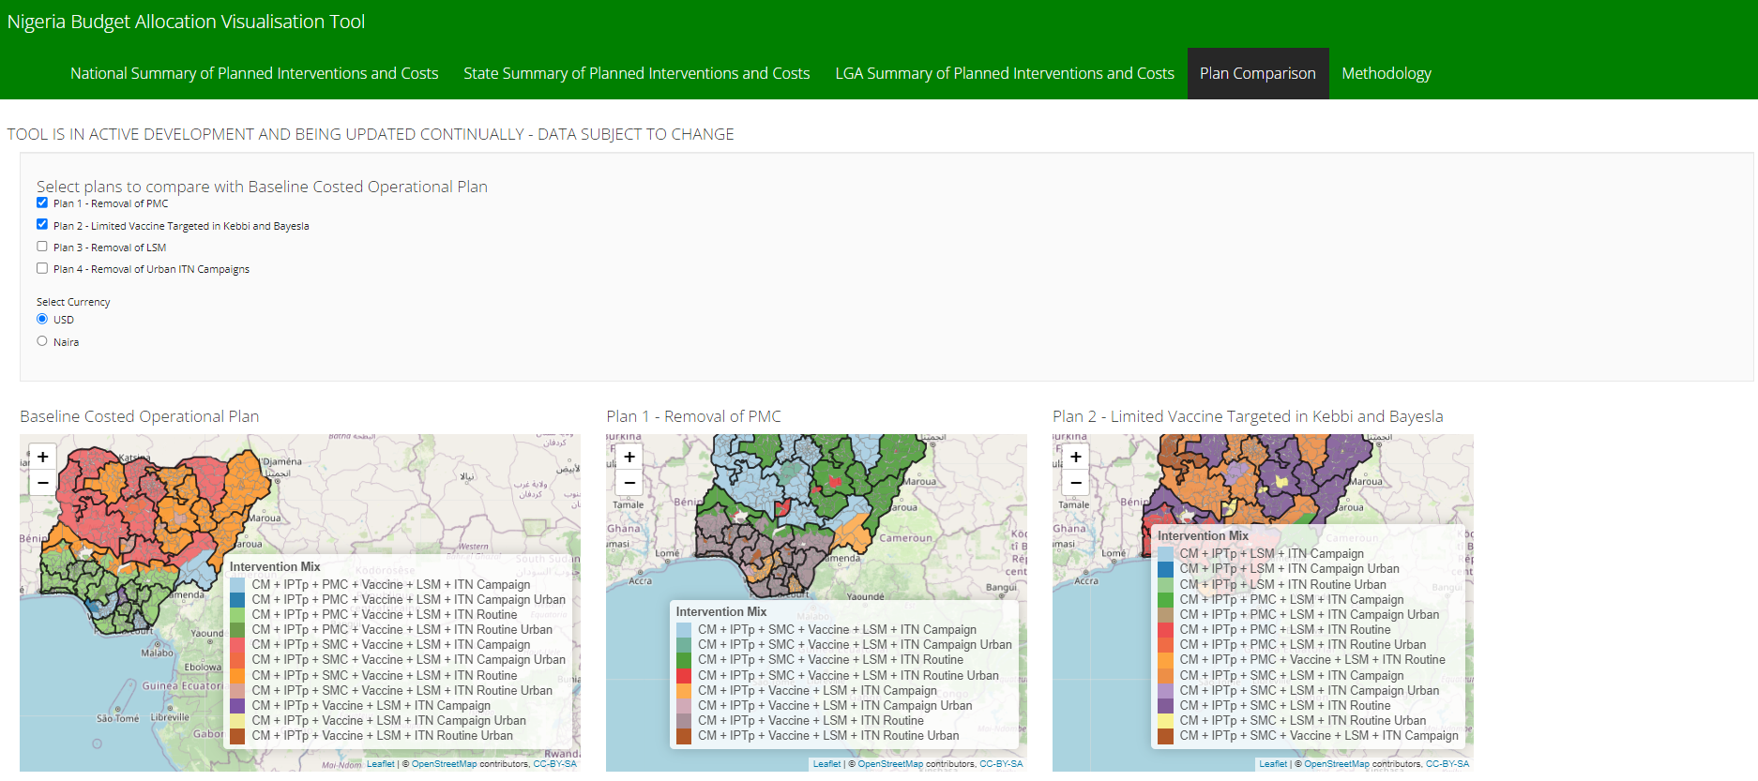

Slide 13
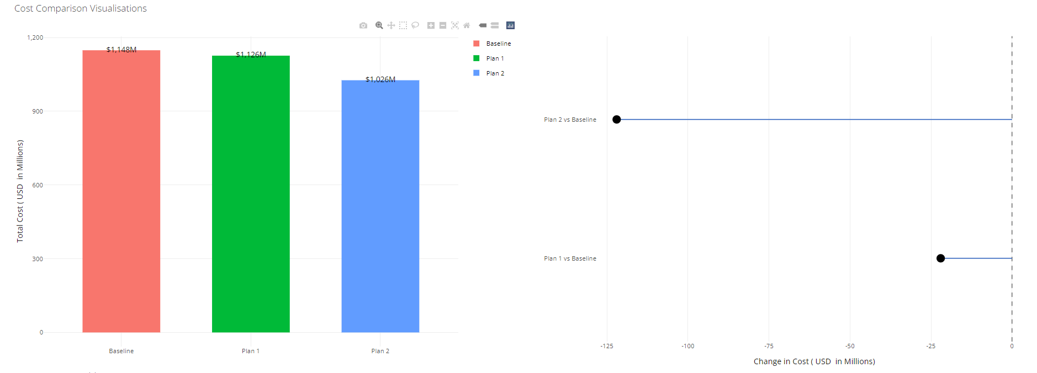

Slide 14
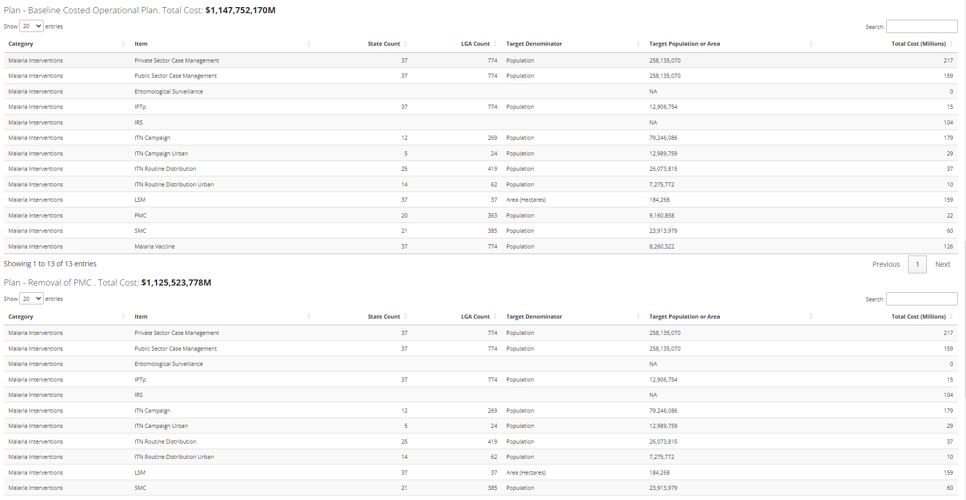

Slide 15
Individual plots

Slide 16
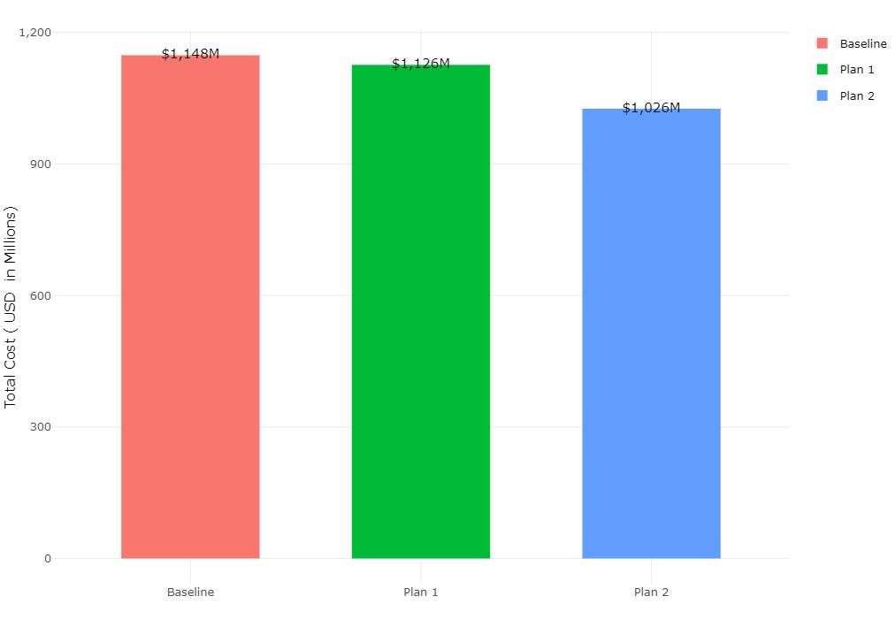

Slide 17
